Slide 1
Global AI Night 2021
By: Vinay Venkatesh
Lynbrook High School, San Jose, CA
Vinayven.com
GitHub.com/Simple2006
Linkedin.com/in/vinayven

Slide 2
Introduction
Freshman at Lynbrook High School
Avid Programmer and Aspiring Researcher
Languages of Interest: Python, HTML/CSS, JavaScript, Golang Etc.
Frameworks of Interest: ReactJS, TensorFlow, PyTorch
Deep Interest in AI
Computer Vision

Slide 3
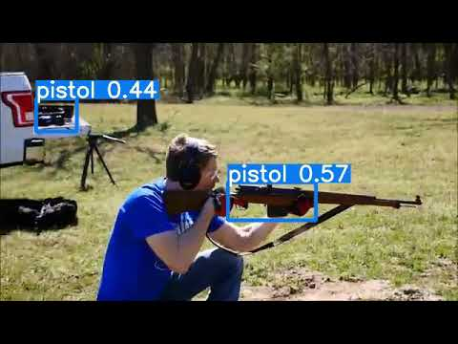
Recent Projects
ArmVision: An Approach to Improve Police Officers Response Times to Gun Violence Crimes and Put a Stop to Them Before They Occur
Computer Vision project utilizing the YOLO Algorithm
Bringing benefit to the real world by upgrading gun safety measures
Libmaths
Mathematical Python library for Python users to graph functions easily
TradeAlgo
Stock Trading Algorithm
VoiceNotes
IOS App (In development) making speech to text easier for disabled students to take notes during lectures and more

Slide 4
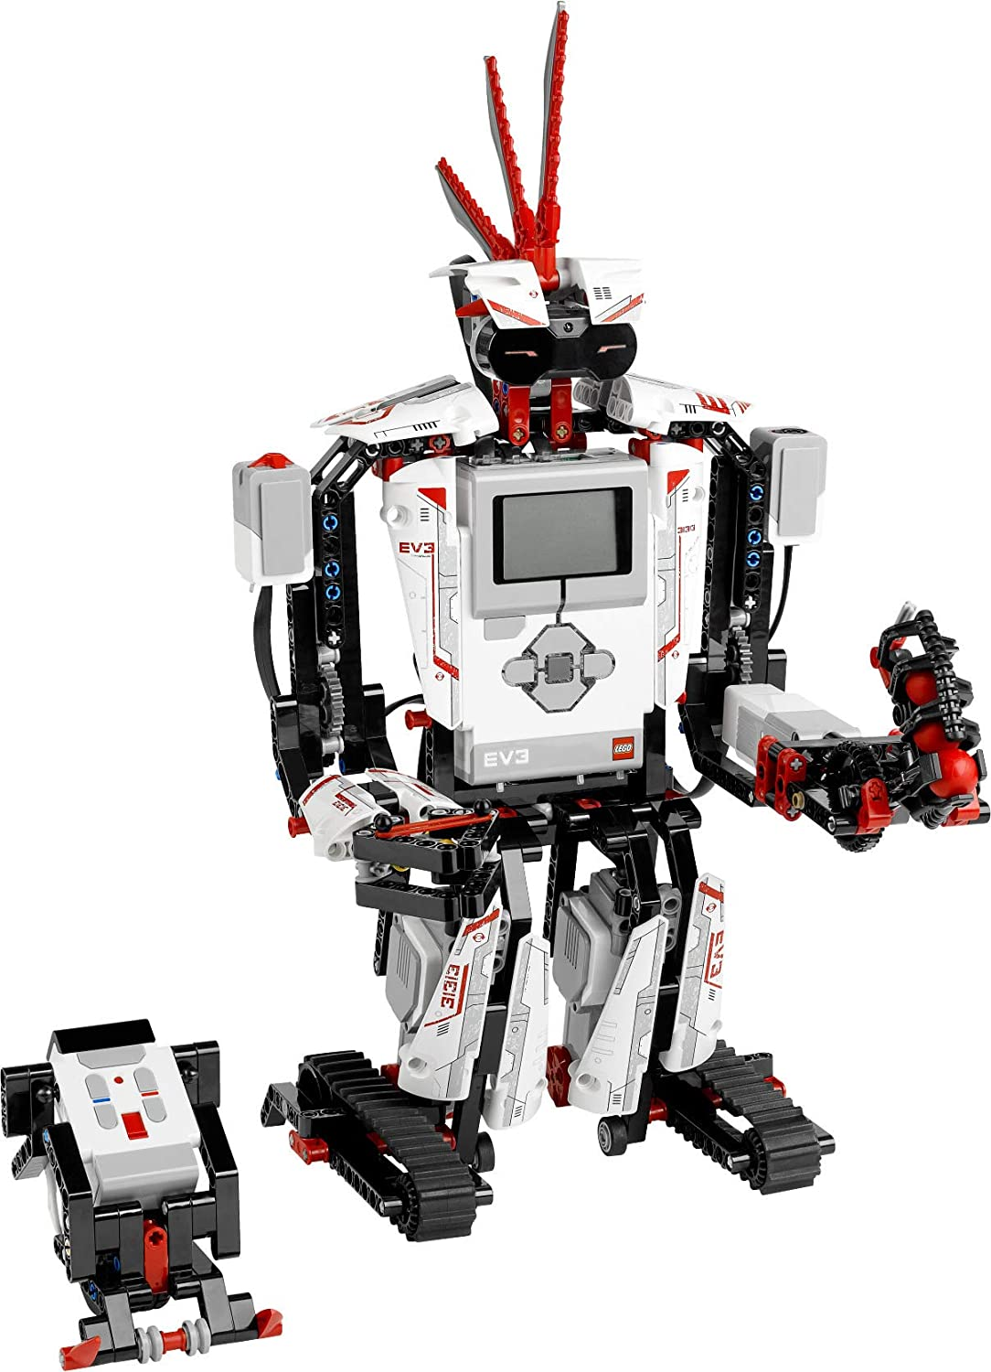
How I Began Programming
LEGO Mindstorms EV3 at age 10
Mix of Software & Hardware
Block Programming and LEGO Hardware
Realized how Important Programming Is Summer2020
Automating everyday tasks
Inventing new things
Easy to learn
Started programming everyday developing new projects to help people and learn new things

Slide 5
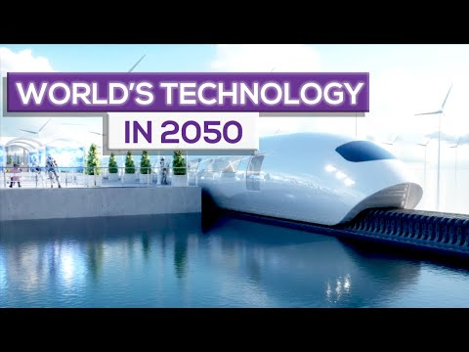
How My Interest In AI Sparked
"AI is The Future"
2:20

Slide 6
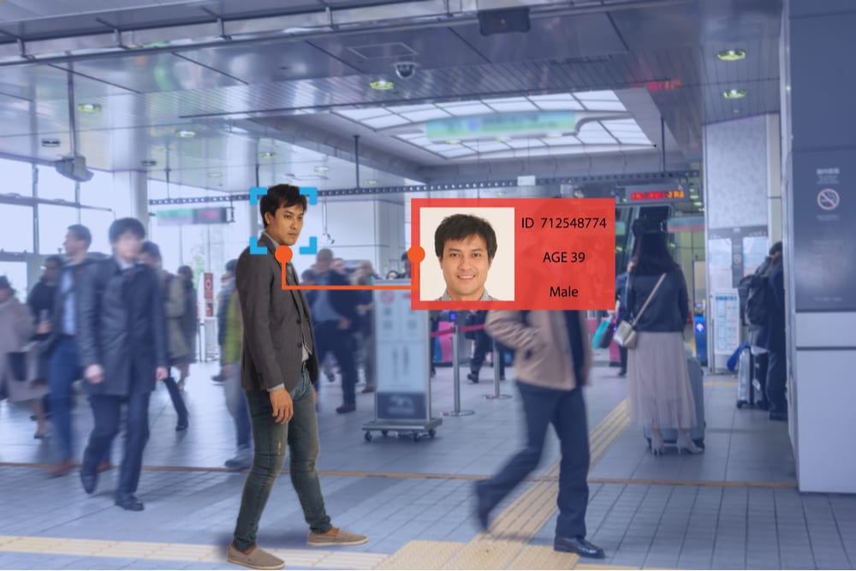
How Will AI Benefit Our Future?
Robotics
Autonomous Robots
Computer Vision
Facial Recognition
Ex. ArmVision
Natural Language Processing
Machines Interpreting Human Language
And More!
“[AI] is going to change the world more than anything in the history of mankind. More than electricity.”— AI oracle and venture capitalist Dr. Kai-Fu Lee, 2018

Slide 7
Real Life AI Solutions
Google's AI Powered Predictions
Analyze movement speeds of traffic at any given time
Commercial Flights
AI Autopilots
Email Spam Filters
Spam Filters Updating With ML Algorithms
Plagiarism Checkers
Used to check source code, essays, and many more

Slide 8
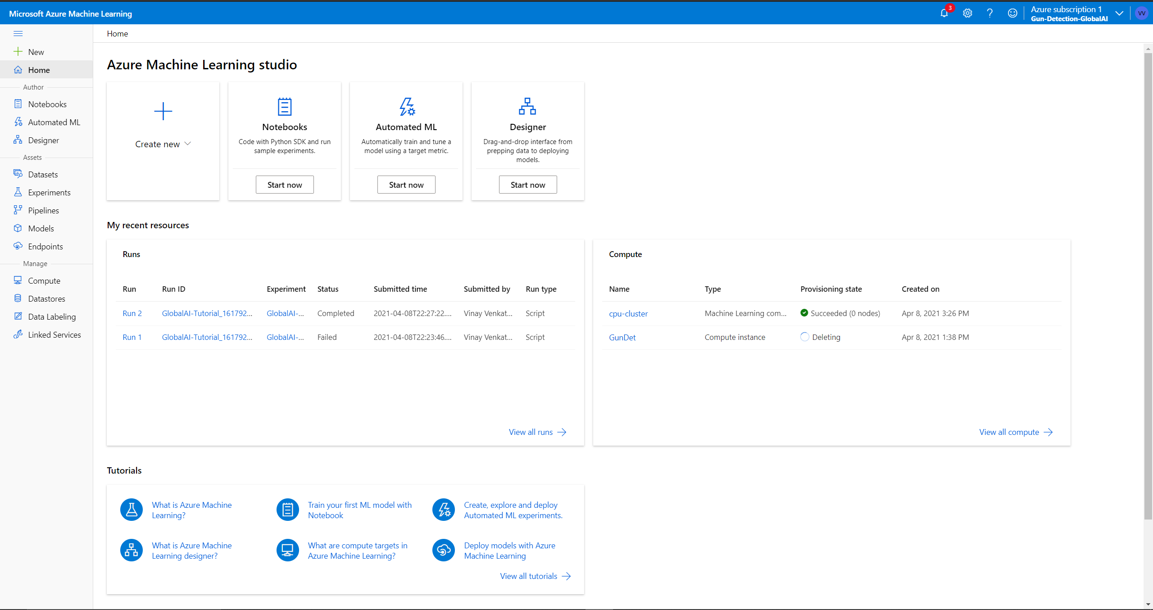
Microsoft Azure ML Platform
Built in Jupyter Notebooks
Organized
Easy to Use
Simplistic Feeling but Great Features
Amazing Training Times
Descriptive & Interactive Tutorials
$200 Credit Upon Sign-Up

Slide 9
Azure ML Platform Project Demo
We will now start an Image Classification project using the Azure ML Platform.
Please try to follow along if you can, don't worry if you can't because all code will be posted on my GitHub @ GitHub.com/Simple2006

Slide 10
Thank You Everyone!
Vinayven.com
GitHub.com/Simple2006
Linkedin.com/in/vinayven

